Slide 1
ABC Call Volume Trend Analysis

Slide 2
Content
1
2
3
4
Insight
5
Result
  Project Description
  Approach
  Tech – Stack Used

Slide 3
Project Description
The objective of this project is to analyze the inbound call data of ABC Insurance Company to derive insights and propose strategies for optimizing call handling efficiency and minimizing abandon rates.
The project involves data analysis, including segmentation of calls into time buckets, calculation of average call durations, visualization of call volume trends, and strategic manpower planning based on current and predicted call patterns.
The project will deliver insights into call duration patterns, visual representations of call volumes, manpower allocation strategies to reduce abandon rates, and a comprehensive plan for handling both daytime and night time calls effectively.

Slide 4
Approach
Data Preparation:
  Data Cleaning: Removal or imputation of null values, elimination of duplicates, handling outliers, and removal of irrelevant columns to ensure data quality.
2. Data Analysis:
  Pivot Tables and Functions: Using pivot tables and functions to aggregate and summarize data across different dimensions and variables.
  Graphs/Charts: Visual representation of data using graphs and charts to identify patterns, trends, and relationships within the dataset.

Slide 5
Tech- Stack Used
The analysis for this project has been performed using Microsoft Excel as it offers a user-friendly interface that allows users to work with data, perform calculations, and create visual representations without extensive programming knowledge.

Slide 6

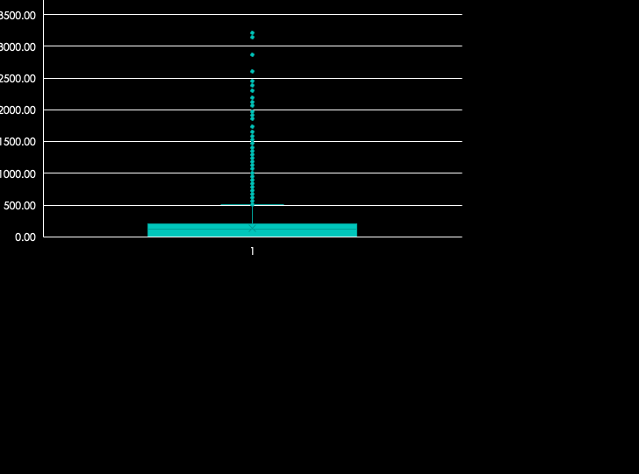

Outlier Analysis

Slide 7
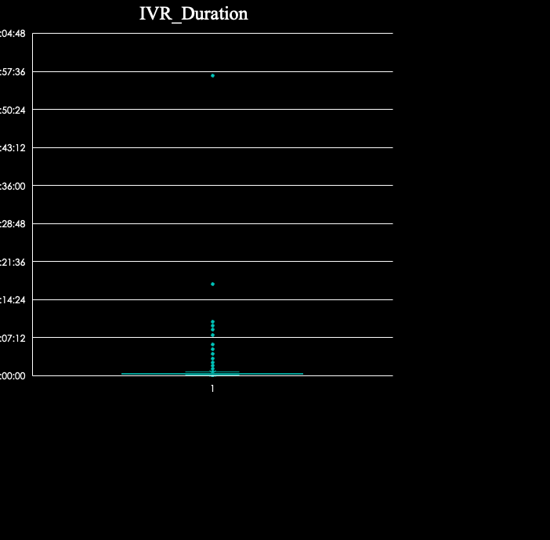

There are outliers in our dataset but the variation is not so extreme, so the data points have not been replaced.

Slide 8
Task 1: Average Call Duration
Call_Status | (All)
Time_Bucket | Min of Time Bucket Start | Average of Call_Seconds (s)
9_10 | 9 | 92.01032541
10_11 | 10 | 97.42402163
11_12 | 11 | 116.7837413
12_13 | 12 | 144.7250237
13_14 | 13 | 149.5409567
14_15 | 14 | 146.9693211
15_16 | 15 | 169.8968228
16_17 | 16 | 181.4393491
17_18 | 17 | 179.7245137
18_19 | 18 | 174.3246753
19_20 | 19 | 144.5825468
20_21 | 20 | 105.9491371
Grand Total | 9 | 139.5321473
The pivot table provides information regarding the average call duration in seconds in each time bucket. The column has been sorted with the help of the created new column “Min of Time Bucket Start”.

Slide 9
The bar chart shows that customer support representatives receive higher average duration calls in the 16-18 hrs time bucket, while in the morning 9-10 time frame, average duration of calls is very low.

Slide 10
Task 2: Call Volume Analysis
Call_Status | (All)
Time_Bucket | Min of Time Bucket Start | Calls received (Count of Time_Bucket)
9_10 | 9 | 9588
10_11 | 10 | 13313
11_12 | 11 | 14626
12_13 | 12 | 12652
13_14 | 13 | 11561
14_15 | 14 | 10561
15_16 | 15 | 9159
16_17 | 16 | 8788
17_18 | 17 | 8534
18_19 | 18 | 7238
19_20 | 19 | 6463
20_21 | 20 | 5505
Grand Total | 9 | 117988
The pivot table provides information regarding the number of calls received in each time bucket during the day. This analysis can help us understand the spread of calls received and let the management be prepared with the need of customer support representatives in each time bucket.

Slide 11
The graph shows that the highest number of calls are received by the customer support representatives during the 11-12 hrs, followed by 10-11 and 12-13, hence more employees should be available during these hours, while the lowest number of calls are received during the 19-10 and 20-21 time buckets.

Slide 12
Task 3: Manpower Planning
Day Call Planning
Call_Status | (All)
Time_Bucket | Min of Time Bucket Start | Average of Call_Seconds (s) | Calls received (Count of Time_Bucket) | Min Agents for 10% abandonment
9_10 | 9 | 92.01032541 | 9588 | 23232
10_11 | 10 | 97.42402163 | 13313 | 32258
11_12 | 11 | 116.7837413 | 14626 | 35440
12_13 | 12 | 144.7250237 | 12652 | 30657
13_14 | 13 | 149.5409567 | 11561 | 28013
14_15 | 14 | 146.9693211 | 10561 | 25590
15_16 | 15 | 169.8968228 | 9159 | 22193
16_17 | 16 | 181.4393491 | 8788 | 21294
17_18 | 17 | 179.7245137 | 8534 | 20679
18_19 | 18 | 174.3246753 | 7238 | 17538
19_20 | 19 | 144.5825468 | 6463 | 15660
20_21 | 20 | 105.9491371 | 5505 | 13339
Grand Total | 9 | 139.5321473 | 117988 | 285893
Agent absence correction factor = days of work X due to holiday X due to breaks* (lunch / snacks X dedication to calls = (6/7) * (26/30) * (7.5/9) * (60/100) = 0.371428571
The management needs to plan for their manpower requirements during the different hours of the day, so that 90% of the calls are answered.
Based on the constraints provided, agent absence correction factor has been calculated.
The list of the number of agents required in each time bucket has been provided in the table.

Slide 13
Task 4: Night Shift Manpower Planning
Night Call Planning
Time_Bucket | Night call distribution | Calls received (Count of Time_Bucket) | Min Agents for 10% abandonment
21_22 | 3 | 3540 | 8578
22_23 | 3 | 3540 | 8578
23_24 | 2 | 2360 | 5718
24_1 | 2 | 2360 | 5718
1_2 | 1 | 1180 | 2859
2_3 | 1 | 1180 | 2859
3_4 | 1 | 1180 | 2859
4_5 | 1 | 1180 | 2859
5_6 | 3 | 3540 | 8578
6_7 | 4 | 4720 | 11437
7_8 | 4 | 4720 | 11437
8_9 | 5 | 5899 | 14294
Grand Total | 30 | 35399 | 85774
It has been provided that for every 100 calls received during the day, 30 calls are received during the night.
Based on the call distribution during the night, the list of minimum number of agents is calculated, so that 90% of the calls are answered.

Slide 14
Excel File Link
https://docs.google.com/spreadsheets/d/1ij_GyI_UA8IgViACvoZDIw-bH6IVUt-c/edit?usp=share_link&ouid=101949921485202693908&rtpof=true&sd=true
Loom Videos Link
https://www.loom.com/share/433488f0638f4314ab845a8bab357ea7?sid=76d472f4-71c5-45ad-8e42-a01cfc7589a6
https://www.loom.com/share/c096590de3b44825878105389cf1ca84?sid=679476bc-42dd-40c0-ab3b-6d0a5a01ab5d

